Slide 1


RBAC Tech Screening Pre
Natural Gas Demand Model
Zhiyang (Madeline) Lin
05/21/2020

Slide 2
Agenda
Brief Introduction
Data Source
Methodology
Ideas
Explanations
Struggles
Results
Potential Solutions
Q&As

Slide 3

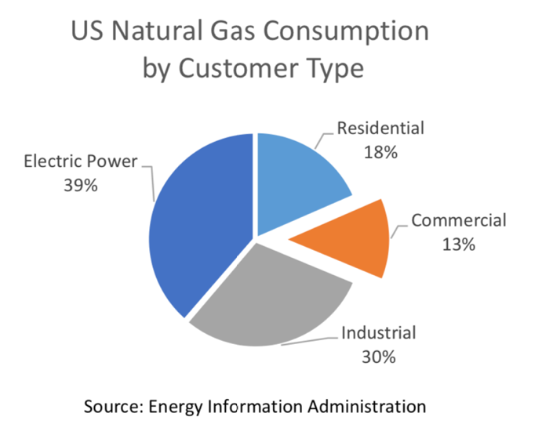
Topic: Natural Gas Demand Model
Region: United States
Period: 1984-2019, by month
Commercial Sector (elaborate more in pre)
Residential Sector
Economic Article: Validator Economic Incentive Model for Ethereum 2.0
Y variable: demand
X variables: price, GDP, population, temperature, policy...

Slide 4
Data Source
Average Monthly Price (from EIA)
commercial https://www.eia.gov/dnav/ng/hist/n3020us3M.htm
residential https://www.eia.gov/dnav/ng/hist/n3010us3M.htm
Quarterly GDP (from St. Louis Fed)
https://fred.stlouisfed.org/series/GDP#0
Average Monthly Temperature (from NOAA)
https://www.ncdc.noaa.gov/cag/national/time-series/110/tavg/all/1/1984-2019?base_prd=true&begbaseyear=1901&endbaseyear=2000
Monthly Population (from St. Louis Fed)
https://fred.stlouisfed.org/series/POPTHM
Policy (see next slide)

Slide 5
Data Source (continued)
Policy
Previous Policy: The Natural Gas Policy Act of 1978
Policy A: FERC Order No. 436 (Open Access Order) in 1985
Policy B: natural gas wellhead decontrol act (NGWDA) in 1989
Policy C: FERC Order No. 636 (Final Restructuring Rule) In 1992
Note: treat as dummy variable (0/1)

Slide 6
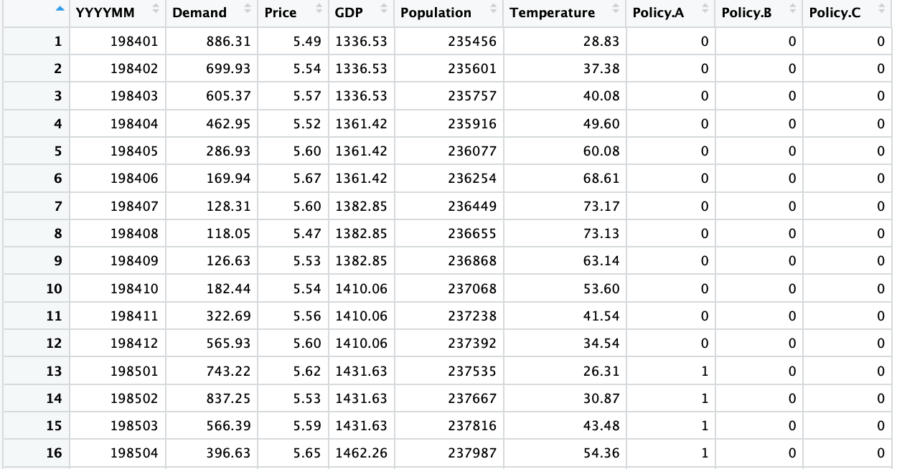
Methodology
Multivariate Time Series Analysis

Slide 7
Vector Auto Regression (VAR)
Y _{t} = κ + α × Y_{t-1} + … + β₁ × X_{1, t} + β₂ × X_{1, t-1} +… + γ₁ × X_{2, t} + γ₂ × X_{2, t-1} + … + ρ₁ × Χ_{3, t} + ρ₂ × X_{3, t-1} + … + ε_{t}
Demand _{t} = κ + α₀ × Demand _{t-1}
+ α­₁ × Price _{t} + α₂ × Price _{t-1}
+ β₁ × GDP _{t} + β₂ × GDP _{t-1}
+ γ₁ × Population _{t} + γ₂ × Population _{t-1}
+ ρ₁× Temperature _{t} + ρ₂ × Temperature_{t-1}
+ δ ₁ × Policy A_{t} + δ ₂ × Policy A _{t-1}
+ π ₁ × Policy B_{t} + π ₂ × Policy B _{t-1}
+ ι ₁ × Policy C_{t} + ι ₂ × Policy C _{t-1}
+ ε_{t}

Slide 8
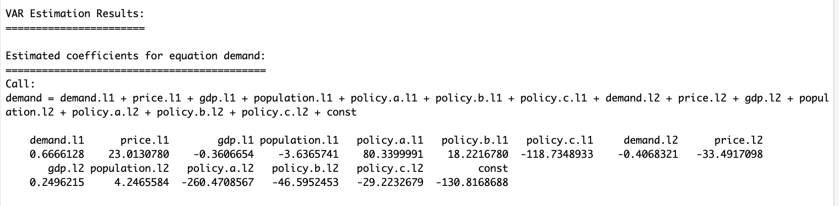
Results
Some struggles of interpretation… ☹

Slide 9
Other Alternative Methods?
1. Smoothed Moving Average Methods (typically for time series data)
Smoothed average forecast: a weighted combination of previous period and forecast
Smoothed forecast_{t} = α * (Actual_{t-1}) + (1-α) * (Forecast_{t-1})
2. Simple Linear Regression
Demand_{t} = κ + α­ × Price _{t} + β × GDP _{t} + γ × Population _{t} + ρ × Temperature _{t}+ δ × Policy A _{t} + π × Policy B _{t} + ι × Policy C _{t} + ε_{t}
3. Cobb-Douglas Demand Function
Demand_{t} = C * (Price)^{α} * GDP^{β} * Population^{γ}
ln Demand_{t} = κ + α * ln Price_{t} + β * ln GDP_{t} + γ * ln Population_{t} + ε_{t}
Shortcomings need to be addressed here:
1. only use quarterly GDP data: /4
2. covid19
3. policy no month, by default supposed to be happen in Jan

Slide 10
Potential Solutions
Open areas for more natural gas exploration
Regulate Appropriately
Empower the states
Eliminate subsidies for the transportation sector
Ensure access to foreign markets
U.S. policymakers should focus on commonsense access and reasonable safety measures – not burdensome over-regulation and market-distorting subsidies.

Slide 11

Hook’em
Q&As
Thank You : )

